Slide 1
Intro to Angular
Hardeep Kaur Dhalla

Slide 2
Objectives
Interfaces
Abstract classes
Method overriding
Static members
ES6 Modules
Optional Chaining
Nullish Coalescing operator

Slide 3
Interfaces
Helps in defining structure of the type.
It specifies a contract for classes to implement.
Classes can implement one or more interfaces.
An interface can extend another interface.
It can have only structure
no initialization of the fields.
Methods without body.
cannot use public or private or protected access modifiers on them.
You can add readonly and optional properties.

Slide 4
Interface
Syntax
interface interfaceName{
//type members – properties and method //defnitions
}

Slide 5
Abstract classes
“abstract” keyword will be used to create abstract classes and methods.
Syntax: abstract class ClassName{
// other members
// abstract methods – methods without body
abstract someMethod():void;
}
Can only be extended.

Slide 6
Overriding keyword
Method overriding helps in redefining the behavior of a method already defined in the parent class.
When a method is marked with ”override”, TypeScript will always make sure that a method with the same name exists in the base class.

Slide 7
Static members
Classes may have static members. These members aren’t associated with a particular instance of the class.
They can be accessed through the class name itself.
Static properties and methods are shared by all instances of a class.
Static and non-static fields with the same name can exists without any error.

Slide 8
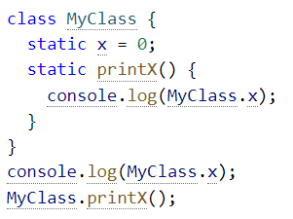
Static members

Slide 9
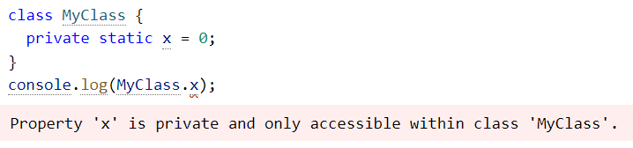
Static members
Static members can also use the same public, protected, and private visibility modifiers .

Slide 10
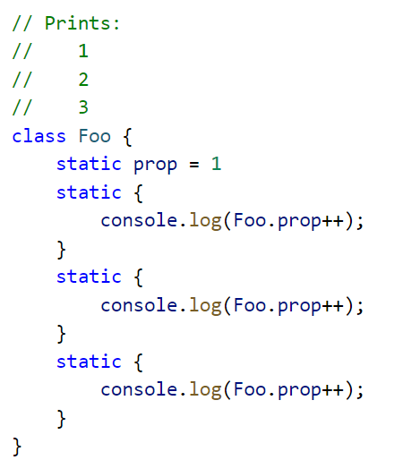
Static code blocks
You can also add static blocks in the class for initialization purposes.
Note that a class can have multiple static blocks, and they’re run in the same order in which they’re written.

Slide 11
Static members
Classes may have static members. These members aren’t associated with a particular instance of the class.
They can be accessed through the class name itself.
TypeScript (and JavaScript) don’t have a construct called static class the same way C# and Java do.

Slide 12
Static members
Static members can also use the same public, protected, and private visibility modifiers

Slide 13
modules (export, import)
Each Typescript file that you add to a project is a module.
All the classes, functions and variables defined in that file will be accessible to that file only by default.
Use ‘export’ keyword to make them accessible outside of the module.

Slide 14
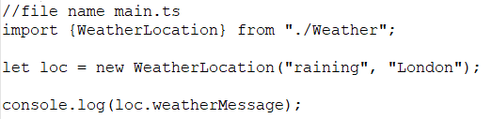
modules (export, import)
the ‘import’ keyword is used to declare a dependency on the features that a module provides.

Slide 15
Renaming imports
In complex projects, you might need to import two classes with same name from two different modules.

Slide 16
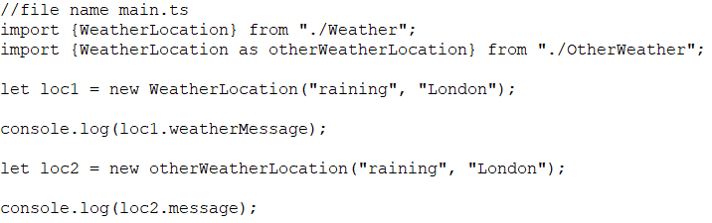
Renaming imports
An import can be renamed using a format like import {old as new}:

Slide 17
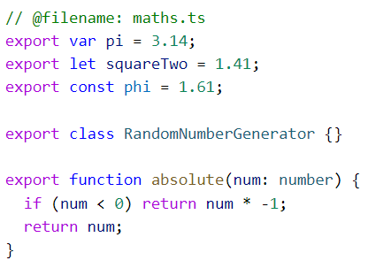
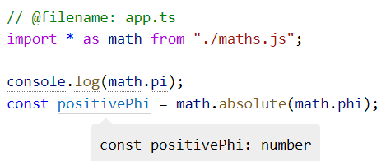
Importing all types in a module
You can take all of the exported objects and put them into a single namespace using * as name:

Slide 18
Optional chaining ?.
optional chaining lets us write code where TypeScript can immediately stop running some expressions if we run into a null or undefined.
Example: let x = foo?.bar.baz();
when foo is null or undefined, stop what we’re doing and just return undefined.
https://www.typescriptlang.org/docs/handbook/release-notes/typescript-3-7.html

Slide 19
Nullish Coalescing Operator ??
This operator provides a way to “fall back” to a default value when dealing with null or undefined.
Example: let x = foo ?? bar();
Again, the above code is equivalent to the following.
let x = foo !== null && foo !== undefined ? foo : bar();

